Slide 1
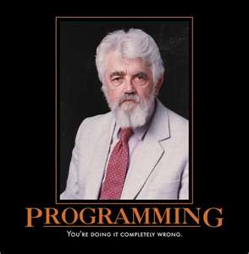
Learning to Love Being Wrong
The Why and How Of Test Driven Development

Slide 2
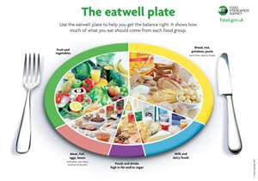
On the plate for today
Developer methodologies
Why Agile methods and TDD are best
How to test using Visual Studio
One hands on exercise
A couple of tips
New standards for production rulez

Slide 3

What are you building?
A bridge?
Need to gather everything before you start
You know the end goal
Once implemented Changes are costly
Not likely to need constant changes

Slide 4

Software
Changes are a sure thing
The requirements will change
Customers will change their mind
There are always scenarios that can’t be predetermined
So whatcha’ gonna’ do?
Agile methodologies were created to address these issues

Slide 5
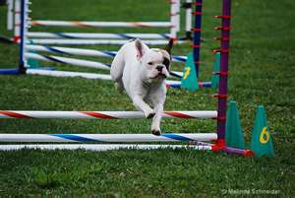
Get Agile
Individuals and interactions over processes and tools
Working software over comprehensive documentation
Customer collaboration over contract negotiation
Responding to change over following a plan

Slide 6
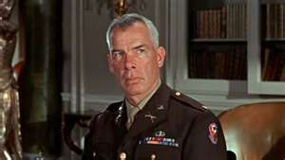
The Dirty Dozen
Customer satisfaction by rapid delivery of useful software
Welcome changing requirements, even late in development
Working software is delivered frequently (weeks rather than months)
Working software is the principal measure of progress
Sustainable development, able to maintain a constant pace
Close, daily co-operation between business people and developers
Face-to-face conversation is the best form of communication (co-location)
Projects are built around motivated individuals, who should be trusted
Continuous attention to technical excellence and good design
Simplicity
Self-organizing teams
Regular adaptation to changing circumstances

Slide 7
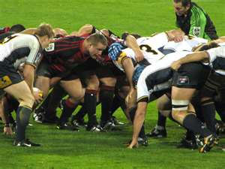
Lots of different methodologies have Agile Principles
Extreme Programming (XP)
SCRUM
Lots more
Ontimenow is a SCRUM based system

Slide 8
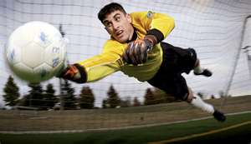
How do you get these goals?
Most important part is to automate the test process
If a customer can change at whim, you need to verify it didn’t blow up other parts of your software
Thus->Test Driven Development

Slide 9
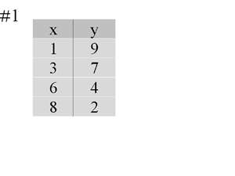
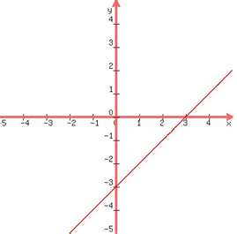
The basic idea
Start with small things you want to do
Remember if X then Y
Example
Show what workstations are open
Add a record with the fields x, y and z
Display a record

Slide 10

Think User Interaction
The goal is to deliver software
Don’t think the bigger picture if it slows you down
Bottom up programming
Think how to do I verify that something worked correctly
Use-Case Scenarios

Slide 11

The Test Methodology-Class
Write a class of what you are going to do
Think of it as a thing-use object oriented principles
Create a constructor
Leave in the exception
Create a unit test via the wizard
Test that object is created

Slide 12

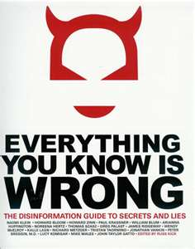
Yes-> Start with Failure
Type 1 Errors
False Positive
The test says you passed but you didn’t test what you thought
Test against null first

Slide 13
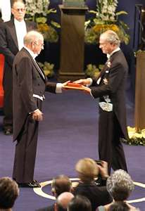

Story Time
Daniel Kahneman and the Isareli Fighter Pilot Teachers
Teachers claimed that feedback is not good
When they complimented the pilot they always did worst and when complained did better
Do you see the teacher’s logic error?

Slide 14
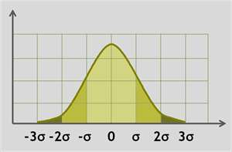
For Whom The Bell Tolls
Due to regression to the mean
In stochastic process, if you did unusually bad or good your next try will be closer to the mean
This misunderstanding prompted the study of Behavioral Economics
The conclusion is people (you and me) are really not that rational-we take shortcuts (hueristics)

Slide 15
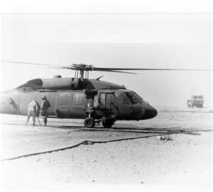
The point of the story
Sometimes data without understanding of the big picture will lead you astray
So always test for failure first

Slide 16
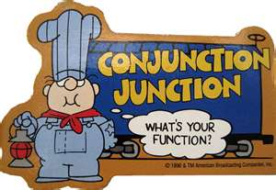
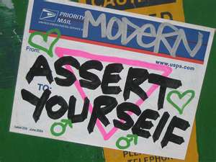
Assert Yourself
Assert.AreEqual(expected,actual)
Assert.AreNotEqual(expected, actual)
These are like And, But and Or they get most of the work done

Slide 17
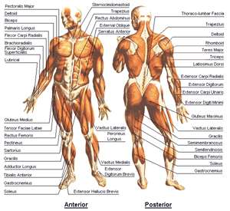
Anatomy of a Test
TestContext
Setup everything for various tests
Always runs before a test
[TestMethod()]
[ExpectedException(typeof(ArgumentException),“homie don’t play that")]

Slide 18
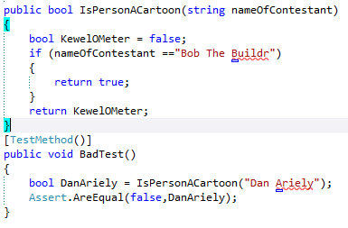

An example of why to fail

Slide 19
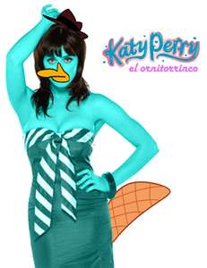
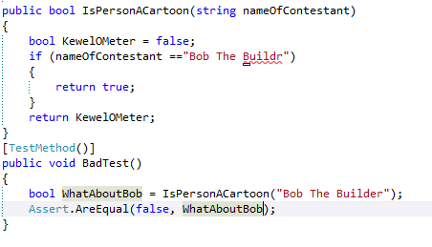
A better test

Slide 20
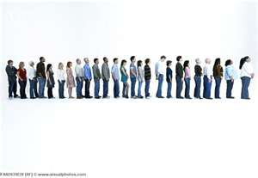
Let’s look at a real world application
CatQ Application
Thinking about the things
Lobby
4 Stations->Worked by Staff
Customers->Students or parents
What happens
Customers pick up tickets
Stations process these customers

Slide 21


Look at one particular object
Arizona related person
Could be a student or not
Student can enter netid or EMPLID
Student or parent can enter name

Slide 22
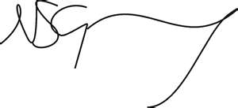
Signature
public ArizonaRelatedPerson(string NetIdOrEmplidOrUnknown)
public string NetId
public string FullName
public string EMPLID
public int PersonType

Slide 23

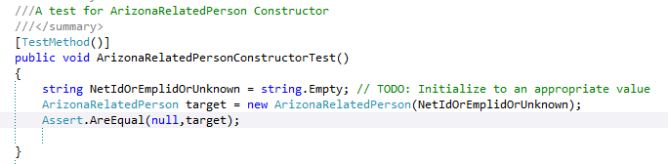
First test
Constuctor test

Slide 24
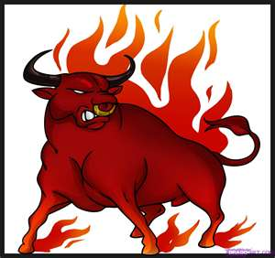
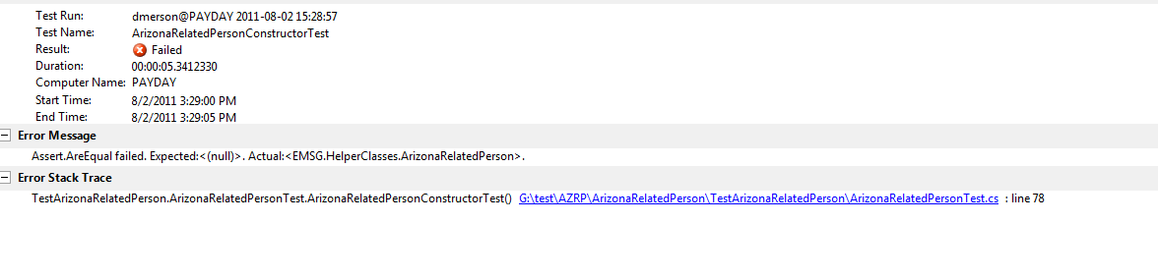
Red is good for first test
Always start out with null
It will tell you what the value is!

Slide 25
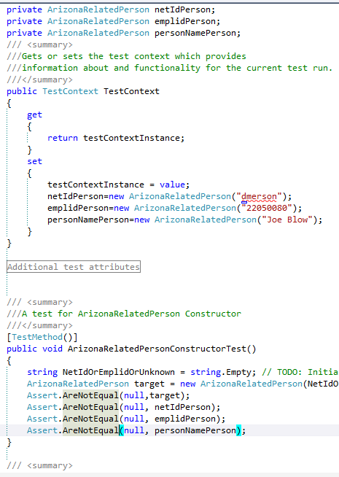

Slide 26
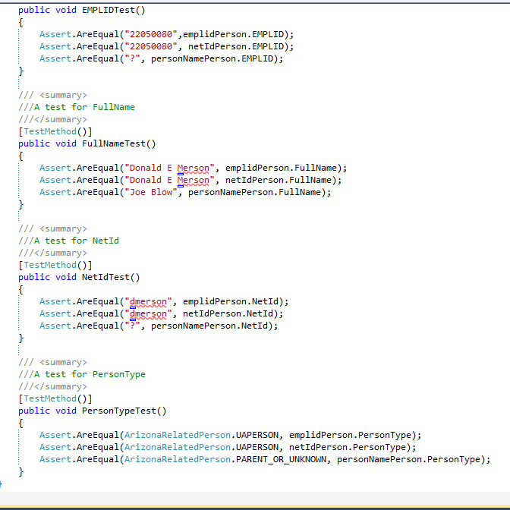

Slide 27
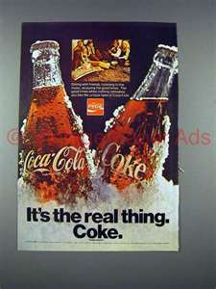
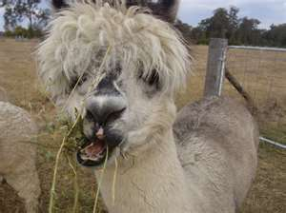
So let’s look at the real thing
https://subversion.em.arizona.edu/svn/SASG_1/CodeReview/ArizonaRelatedPerson/ArizonaRelatedPerson
There is a big ugly problem with class
Variable names instead of enum
It’s public so can we totally fix it?

Slide 28


Rules for public
If deployment cannot change signature or test results
Can override it or give second meaning
For example-TextBox asp control
.Text ->is the same as Input .Value
But doesn’t exist so we could override it so we didn’t have to distinguish

Slide 29
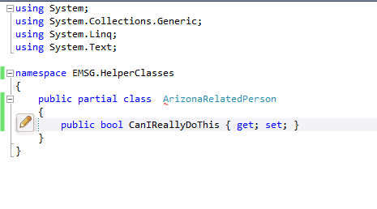
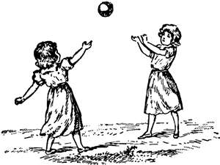
Playing the part
Partial classes can allow people to add to it without having to recompile
Same as in aspx pages
Cs and aspx page are the same class

Slide 30

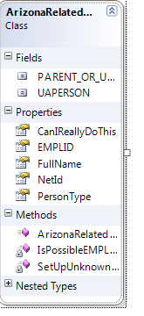

Slide 31
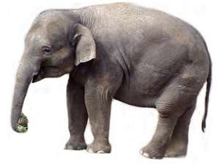
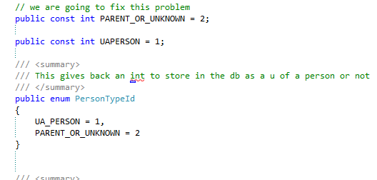
Fix the elephant in the code
Using named const should be enum
Let’s break it!

Slide 32
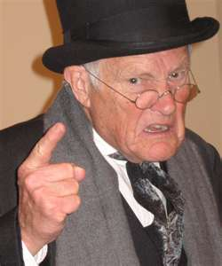
Change to enum
Hit compile
Boom! Fix compile errors
Run tests
Red flag
Use Cntl-R-Contl-T to run debug on test

Slide 33
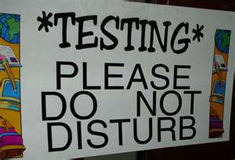
That is why we test
We can break and we can find out what we broke
We can leverage everyone with this approach
Everyone has special logic which we can make into a dll
This is a major reason –Data->Logic->Presentation

Slide 34
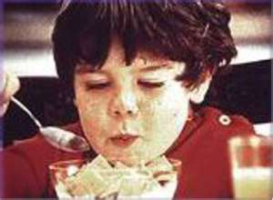
Let’s try one
Create a basic class and a test using Visual Studio

Slide 35

Some special notes
Telerik has way to test presentation
SASG-VW7-1 has the tool
Take a quick peak!
You can download from Ultimate
You can use SubSonic and test your database info

Slide 36

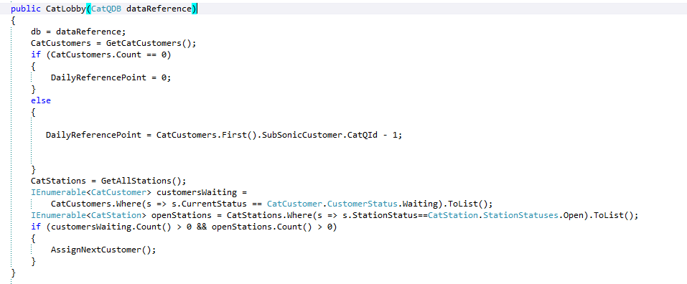
How to test with subsonic
Create your objects by passing the db reference

Slide 37
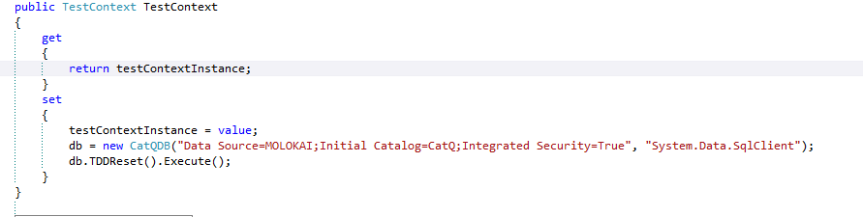
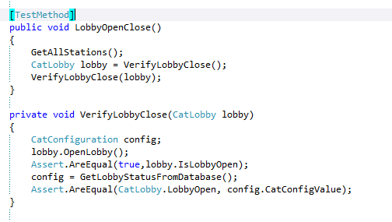

Slide 38
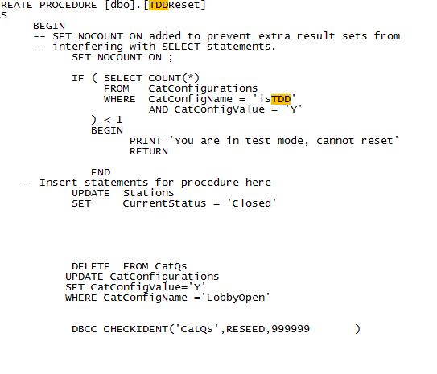
Write an SP to restore orginal state

Slide 39
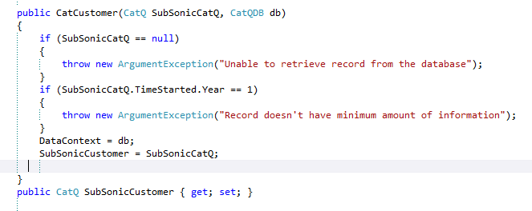
Other tricks
Make SubSonic Table a Public Property of Class

Slide 40
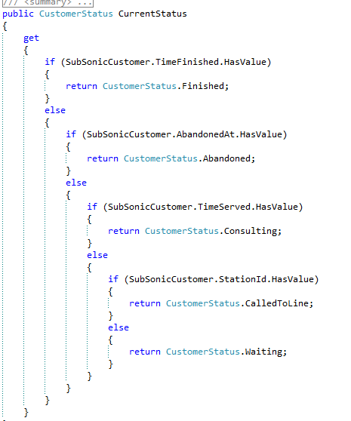
So now abstract from the data

Slide 41
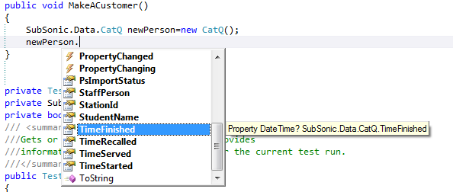
You can also just create SubSonic Object to Test

Slide 42

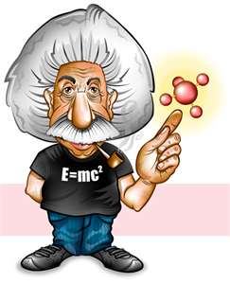
To test is to know….
But let’s take baby steps so we don’t stress everyone out
First Steps
Find good places for logic
Create tests for them
Use these objects in your project

Slide 43
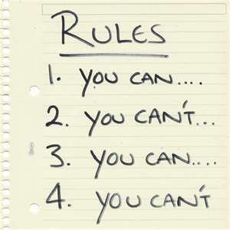
Rules for deployment
We should be able to compile the code from Subversion
All public methods have summary comments
All variables say what they are
All methods say what they do
Documentation in Confluence
Signoff of customer via email

Slide 44
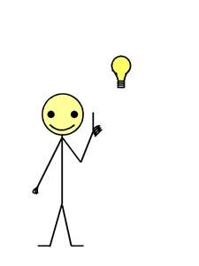
In conclusion
TDD evolved because of the needs of software developers
We can use it
We should use

